Slide 1
Learning Session 1
Quick Review of CLICQ! and an
Introduction to the D-M-A-I-C Model

Slide 2

The presence of the Laboratory African Regional Collaboration (LARC) logo on slides
indicates that content (in whole or in part) originates with the LARC Program

Slide 3
Why Quality Improvement?

Slide 4
It is all about CHANGE!
Old Process
Tests of CHANGE
Multiple PDSAs
Implement the New CHANGE
Sustain the New CHANGE
LARC Workbook

Slide 5
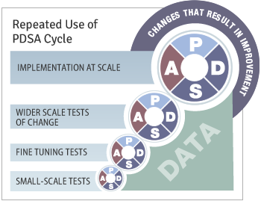
Quality Improvement Overview
Define
Measure
Analyze
Improve
Control
LARC Workbook

Slide 6
Quality Improvement
“The combined and unceasing efforts of everyone—healthcare professionals, patients and their families, researchers, payers, planners and educators—to make the changes that will lead to better patient outcomes (health), better system performance (care) and better professional development.”
                Paul B. Batalden and Frank Davidoff
What is "quality improvement" and how can it transform healthcare? Qual Saf Health Care. 2007 Feb; 16(1):2-3.
LARC Workbook

Slide 7
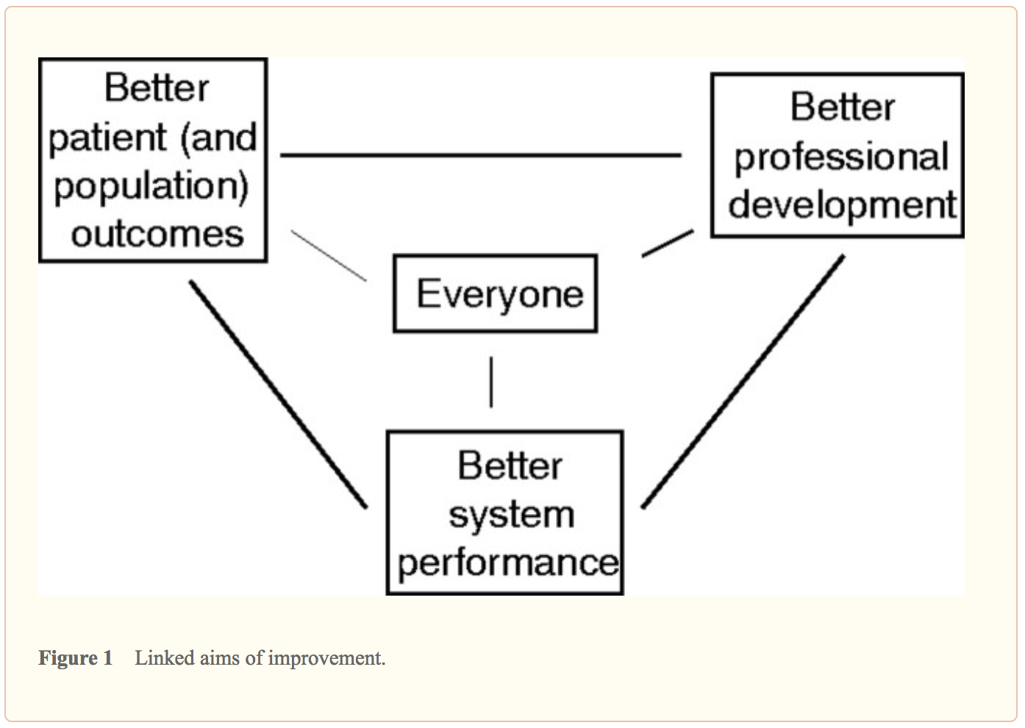
What is “quality improvement” and how can it transform healthcare?
Qual Saf Health Care.
2007 Feb; 16(1): 2–3.
LARC Workbook
Notes:
Focus on these three components - Moving to How QI achieved…focus on these three components to share some examples of

Slide 8
Why CLICQ!?

Slide 9
The great aim of education is not knowledge,
but action!
- Herbert Spencer

Slide 10
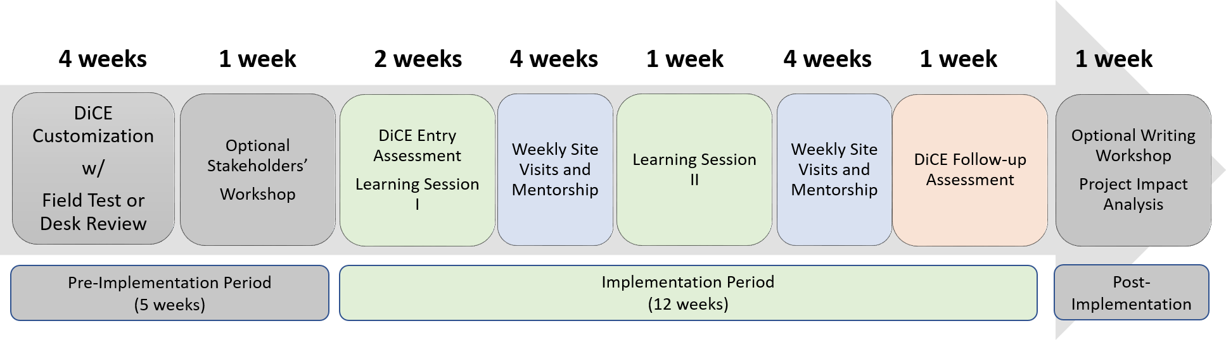
CLICQ! = Action
NOTE: timeline estimates are only examples and can be modified depending on local context (e.g., program needs, available budget, and available expertise, etc.)

Slide 11
Purpose/Expectations of CLICQ!
To create an improvement culture where collaborative team members work together to understand and utilize practical CQI tools and processes:
  To successfully complete at least one QI project
AND
  To always act on continuous process improvement for the future!

Slide 12

Embed Improvement in your DNA
LARC Workbook

Slide 13
Who?

Slide 14

Do you have what it takes to be a quality ninja?
Wear the Glasses
  See Opportunities for Improvement (OFI)
Passion for Improvement
Ability to Engage Others
See the Big Picture
  Yet also give Attention to Detail
Learn & Use Continuous Quality Improvement (CQI) Tools skillfully
Outcome driven
Grit (Perseverance)
QUALITY
LARC Workbook

Slide 15
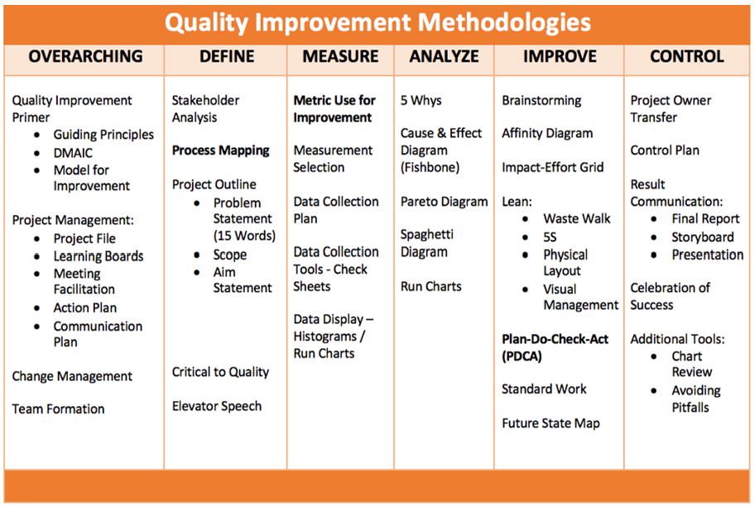
LARC Workbook

Slide 16
Overview of CLICQ! Learning Sessions
DiCE Entry Assessments | Learning Session 1 |  | Learning Session 2
Facility Tour Data Abstraction Data Entry Data Analysis Site Report Writing Site Debrief | CLICQ! Overview CQI Overview Process Mapping Overview Process map activity Walk the process Update process maps Opportunities for Improvement Impact / Effort grid DMAIC Overview DEFINE / MEASURE Project Outline Problem Statement Scope Aim Statement / Metric | Action Plan Communication Plan Data/Measurement ANALYZE ‘Fishbone’ activity 5 Whys, Cause & Effect Diagram, Pareto Diagram, Run Charts, Control Charts | CQI Revisited DMAIC Revisited Facility Presentations IMPROVE Simulation Before/After PDSA / Small Test of Change Lean 5S Visual Management Physical Layout Standardized Work | Data Display Creating a ‘Run Chart’ CONTROL Control Plan Result Communication Final Report Storyboard Presentation Spread Best Practices Celebrate Success Additional Tools Chart Review Avoiding Pitfalls

Slide 17
CLICQ! Program Deliverables
Learning Session 1
DEFINE / MEASURE / ANALYZE
Learning Session 2
IMPROVE / CONTROL
Identify Stakeholders
Team Formation
Map the Process (Current)
Identify/Prioritize Opportunities
  Improvement Project Outline
Baseline Metrics - Data Collection Tool/Plan
Action Plan
Elevator Speech
Root Cause Analysis
1 Rapid/Small Test of Change (PDSA)
Presentation
  Update Project Outline, if necessary
1 5S Exercise
1 Visual Management Application
2 or more Tests of Change (PDSA)
Select and Implement Change
Modify Solution(s) where necessary by additional Test of Change (PDSA)
Create Future State Map
Create Standard Work
Presentation
LARC Workbook

Slide 18
Learning Session 1
Overarching Themes of the
D-M-A-I-C Model

Slide 19
LARC Workbook

Slide 20
Quality Improvement Primer
Guiding Principles
DMAIC
Model for Improvement
LARC Workbook

Slide 21
Guiding Principles for Quality Improvement
Focus on the needs of the USERS
Focus on PROCESSES to increase
the productivity of work
Use DATA to improve services
Use TEAMS to improve quality
Improve COMMUNICATION
LARC Workbook, p. 6
https://www.larccqi.org/uploads/resources/LARC-3.0-WORKBOOK.pdf
LARC Workbook

Slide 22
It is all about CHANGE!
Old Process
Tests of CHANGE
Multiple PDCAs
Implement the New CHANGE
Sustain the New CHANGE
LARC Workbook

Slide 23
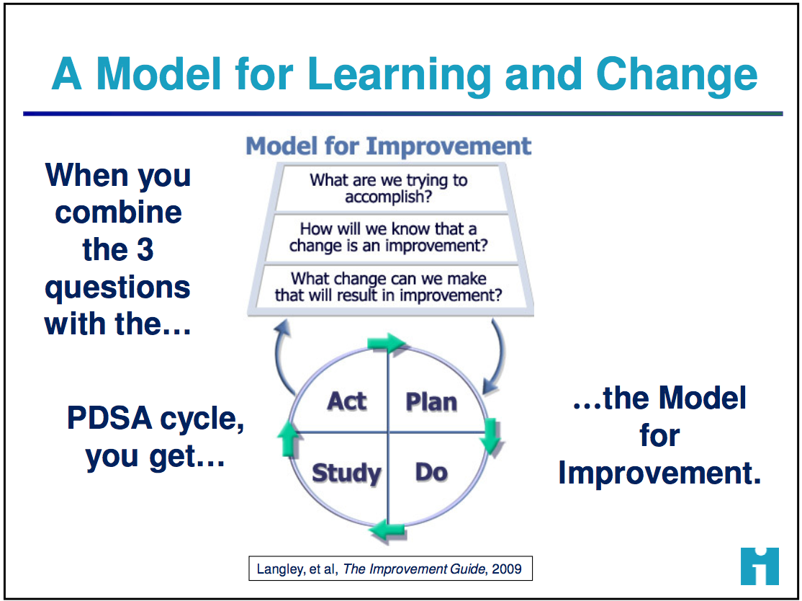
How do we create change?
3 Questions + PDCA = The Model for Improvement
LARC Workbook, p. 8-12
https://www.larccqi.org/uploads/resources/LARC-3.0-WORKBOOK.pdf
LARC Workbook

Slide 24
Quality Improvement Overview
Old Process
Tests of CHANGE
Multiple PDSAs
Implement the New CHANGE
Sustain the New CHANGE
Define
Measure
Analyze
Improve
Control
LARC Workbook

Slide 25
DMAIC = Quality Improvement (QI) Framework
To solve complex problems or improve any process
DEFINE
What is the nature of the problem?
IMPROVE
What changes will we make to address the problem?
CONTROL
How can we sustain and spread the changes?
MEASURE
ANALYZE
What is the magnitude of the problem?
What are the most important causes of the problem?
Problem Statement
Goals, Aim, Timeline
& Scope
Select Metric
Collect Data
Identify Root Cause
Test and
Select Changes
Monitor Process
Communicate &
Share Successes
LARC Workbook, p. 7
https://www.larccqi.org/uploads/resources/LARC-3.0-WORKBOOK.pdf
LARC Workbook

Slide 26
Project Deliverables
Learning Session 1
DEFINE / MEASURE / ANALYZE
Identify Stakeholders
Team Formation
Map the Process (Current)
Identify/Prioritize Opportunities
  Project Outline
Baseline Metrics - Data Collection Tool/Plan
Action Plan
Elevator Speech
Root Cause Analysis
1 Rapid/Small Test of Change (PDSA)
Presentation
LARC Workbook

Slide 27
Small Test of Change = PDSA

Slide 28
The Model for Improvement (IHI)
Aim
What are we trying to accomplish?
Measure
How will we know that a change is
an improvement?
Change
What change can we make that
will result in improvement?
Small tests of change
Act
Plan
Study
Do
LARC Workbook
Notes:
Improvement techniques are Formal methods to test changes in the steps of a process and seek to achieve greater process reliability more efficiently and at less cost
- Best to use an example like weight loss
- Reliable Process-a set of steps that when performed achieves the same result with minimum variation over time. The likelihood that a process will achieve its desired outcome is dependent on the variability of each step and the total number of steps. Reliability goes down as the number of steps increase and as the variability of the steps increases
- Test of Changes
- A test of change alters a step in a process and evaluates the impact of that alteration
- There are 3 questions to ask prior to a test of change or Plan, Do, Study Act PDSA
What are we trying to accomplish?
How will we know that a change is an improvement?
What change can we make that will result in improvements?
- PDSA’s don’t result in success or failure, they generate learning
- 4 components of PDSA
- Plan-develop an action plan to run the cycle. Predict the expected result. The who, what, where, and when. Keep it simple, only one change at a time, one shift, one day, etc.
- Do-perform the action plan
- Study-evaluate the change, and whether it performed as predicted
- Act-Reflect on what happened and use the learning to begin planning for the next test of change
- How to determine what test of changes to do
- First have a clear Aim, which means the team knows what to work towards
- Reflect on the major factors or drivers that will influence achieving the goal. This helps to focus the group’s efforts and decreases the likelihood that unnecessary work will occur
- Determining the major factors or drivers helps to limit the interventions or actions to the few that are most likely to help achieve the goal.
Plan
State the objective of the cycle, what are we trying to accomplish?
Make predictions
Generate solutions
Develop the plan to carry out the cycle (who, what, where, when)
Do
Test the change
Document problems and unexpected observations
Analysis the data
Study
Complete the analysis
Compare the data to predictions
Summarize learning's
Act
Make changes to the process
Standardize the process
Select the next cycle
What change can we make that will result in improvement?

Slide 29
PDSA – Iterative Cycles
The Rule of One - A 1:1:1 test (e.g., “1 provider, 1 patient, 1 encounter”) is a useful rule for early PDSA cycles.
The Five Times Rule says to multiply the number of encounters or events used in the last cycle by five when scaling up a test of change.
Conducting more than one test at the same time (i.e., concurrent test cycles) allows teams to explore more than one set of conditions in parallel.
LARC Workbook
Notes:
The Rule of One - Why would you try to take it to a larger scale if you can’t get it to work with one individual?” I think that’s a powerful way to think about it. If I can’t get something to work for myself, why would I try to get other people to do it?

Slide 30
PDSA - Small Test of Chance (July)
ACT
PLAN
DO
CHECK
Increase # of presumptive TB patients with specimen collected from ___ to 95%
Worked well → Standardize
Did not work → Create new test of change (PDCA)
Worked partially → “Tweak” and begin PDCA #2
Analyze Data (by 29 July)
  Met goal?
  Why/Why not?
Implement patient escorts from the ART and OPD clinics to the DOTS clinic.
Tracking log every Sunday.
30
LARC Workbook
Notes:
Use TB related example such as increase the % of Presumptive TB cases screened/identified

Slide 31
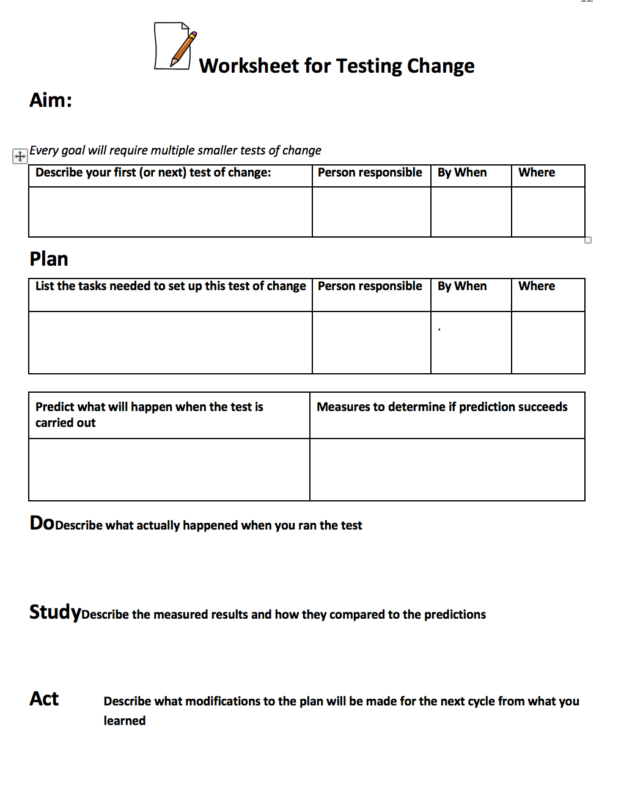
LARC Workbook, p. 12
https://www.larccqi.org/uploads/resources/LARC-3.0-WORKBOOK.pdf
LARC Workbook

Slide 32
Project Management

Slide 33
Deliverables
Project Folder, to include:
  Process Map – Current State & Table
  Project Outline & Plans – Action & Communication
  Data – Collection Plan, Collection Tool with Raw Data; Data Display
  Solutions – PDCAs
  Project History – Lessons learned
Learning Board(flip charts, etc.)
Meeting Facilitation
  Meeting Agenda
  Calendar of all Team Meetings, Learning Sessions, and Workshops
LARC Workbook, p. 15-26
https://www.larccqi.org/uploads/resources/LARC-3.0-WORKBOOK.pdf
LARC Workbook

Slide 34
Project Folder
The Central Repository of Project Knowledge
Process Map / Table
Project Outline
Plans – Action & Communication
Data – Collection Plans, Logs with Raw Data; Display
Solutions – PDCAs
Project History – Lessons Learned
LARC Workbook, p. 18
https://www.larccqi.org/uploads/resources/LARC-3.0-WORKBOOK.pdf
LARC Workbook

Slide 35

Learning Board
LARC Workbook, p. 16-17
https://www.larccqi.org/uploads/resources/LARC-3.0-WORKBOOK.pdf
LARC Workbook

Slide 36
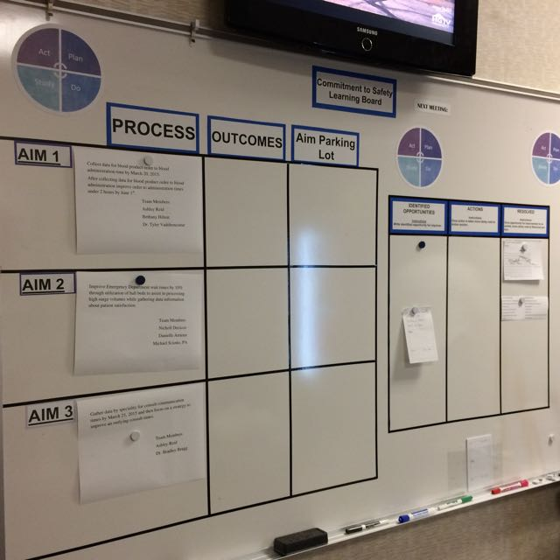
Project – Just Do It
Two sides of the
Learning Board:
Project
Just Do It
LARC Workbook

Slide 37
LEARNING BOARD
PROJECT |  |  | JUST DO IT
Aim / Metric | Changes |  | Identified Opportunities | Actions | Resolved
LARC Workbook

Slide 38
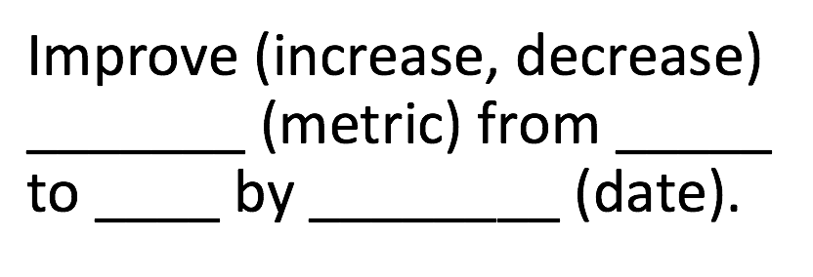
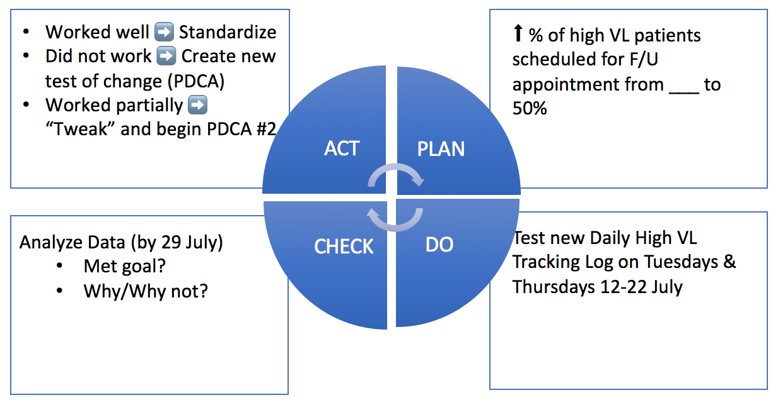
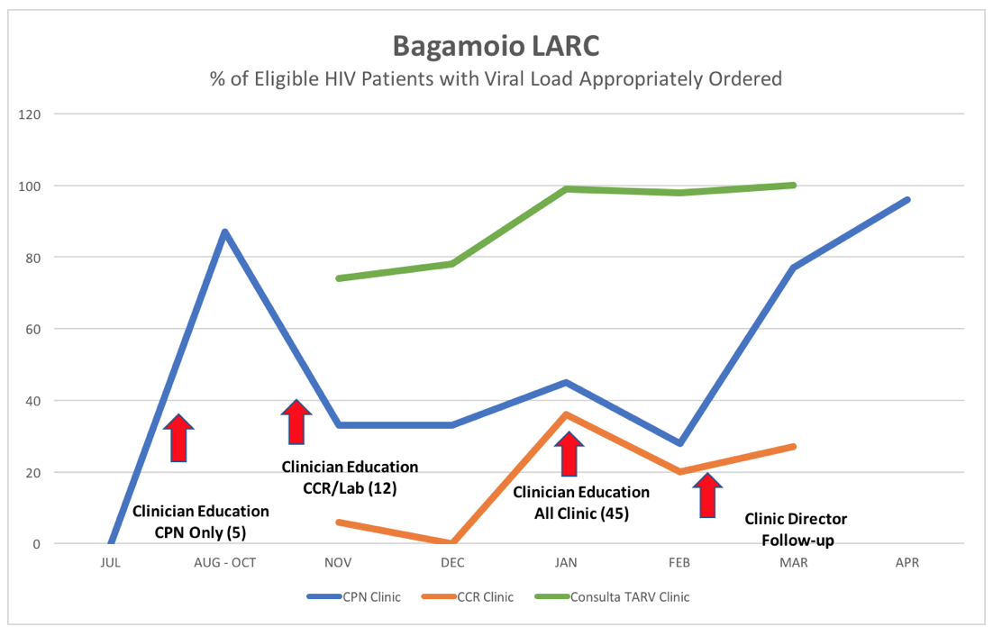
LEARNING BOARD
PROJECT |  |  | JUST DO IT
Aim / Metric | Changes |  | Identified Opportunities | Actions | Resolved
LARC Workbook

Slide 39
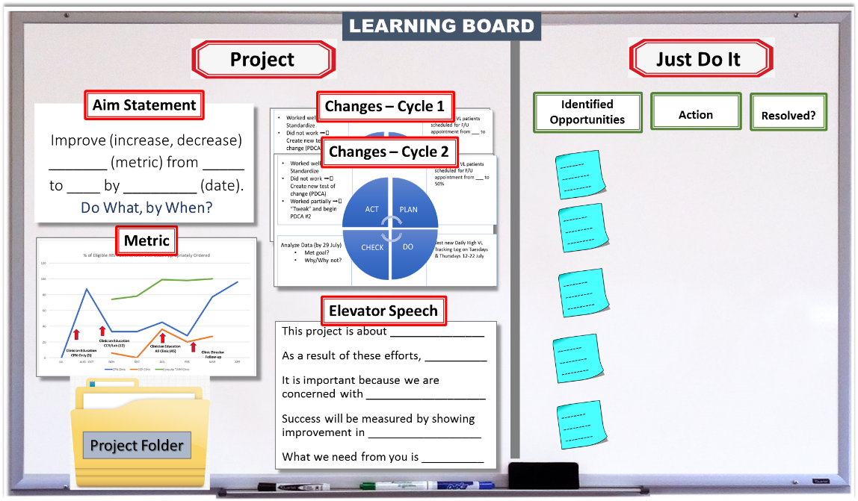
LARC Workbook

Slide 40
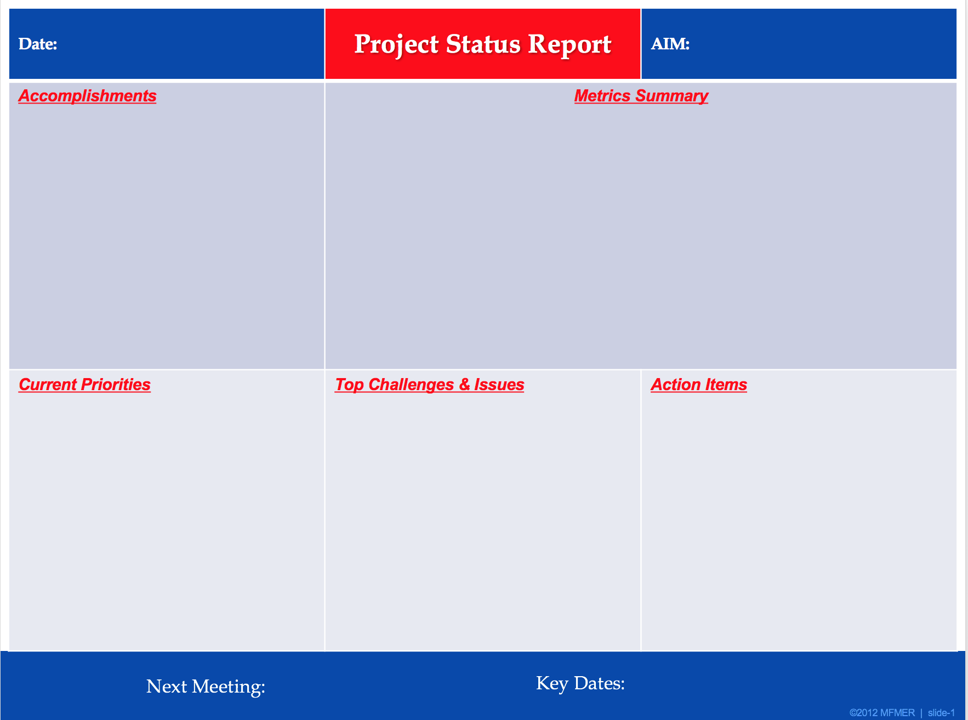
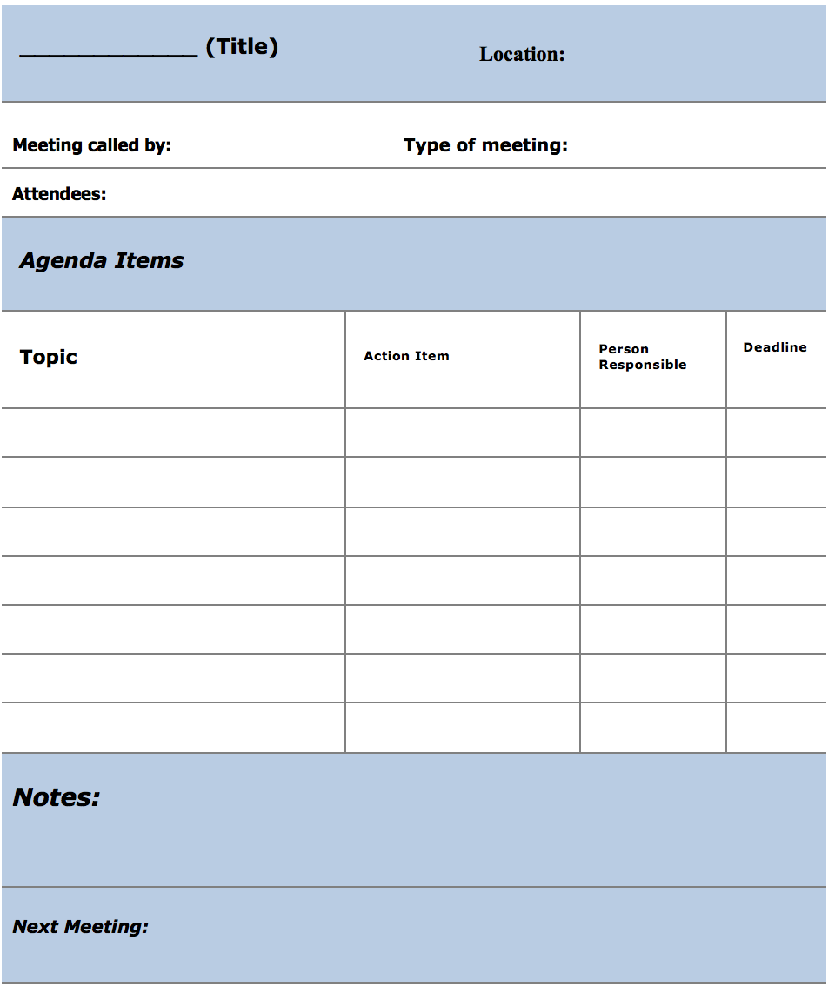
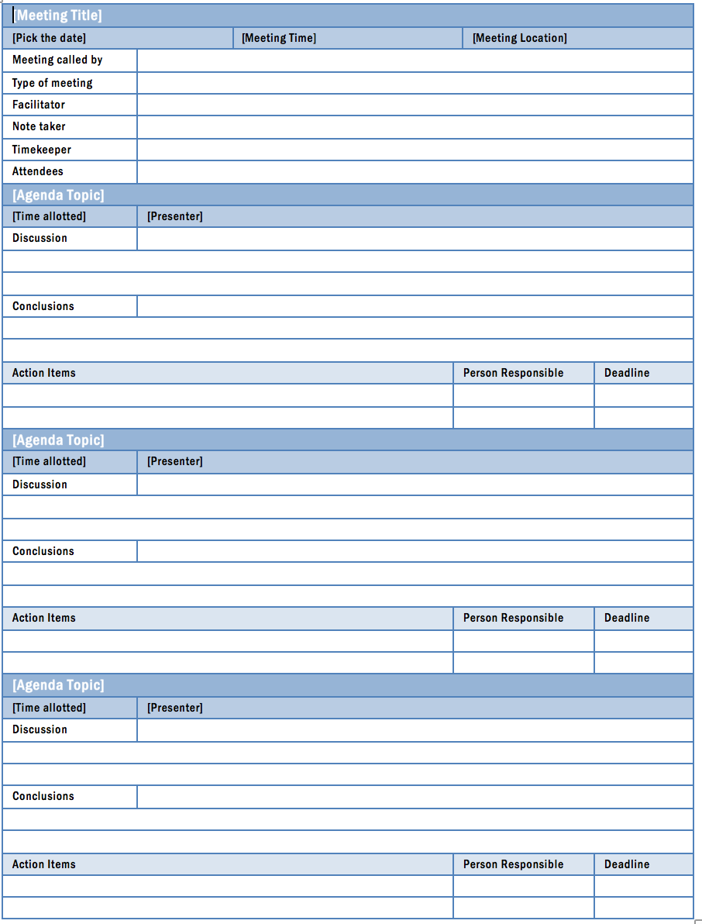
Meeting Facilitation
(what to discuss in the meeting)
LARC Workbook, p. 19-24
https://www.larccqi.org/uploads/resources/LARC-3.0-WORKBOOK.pdf
LARC Workbook

Slide 41
Meetings: Tips for Success
ALWAYS
  Send agenda prior to each meeting
    Team lead to create Agenda & Review Agenda Items & Material prior to meeting
  Only invite those who need to be at the meeting
  Begin & end meetings with Action Items
  Review data – keep project moving toward goal
  Allow time for discussion
  Send meeting follow-up notes with action items
  Keep meetings short – 60 minutes usually or up to 90 minutes if the agenda warrants
SOMETIMES
  Include Site team in Conference Calls with CDC & Central In-country team
NEVER
  Waste team members’ time by conducting a meeting without preparation
LARC Workbook

Slide 42
Action Plan
Topics / Goals (Aim or Just Do It) | Action Item | By Whom? | By When?
LARC Workbook, p. 25
https://www.larccqi.org/uploads/resources/LARC-3.0-WORKBOOK.pdf
LARC Workbook

Slide 43
Action Plan - Example
Action Item | By Whom? | By When?
1. Create Monitoring Sheet | Eke | July 12
2. Supply sample transportation boxes for TB clinic | Laura | July 12
3. Appoint Volunteer to escort patients from DOT clinic to the lab | Emma | July 13
4. Update INH Register | Omo | July 15
LARC Workbook

Slide 44

LARC Workbook

Slide 45
Guiding Principles for Quality Improvement
Focus on the needs of the USERS
Focus on PROCESSES to increase the productivity of work
Use DATA to improve services
Use TEAMS to improve quality
Improve COMMUNICATION
LARC Workbook

Slide 46
Communication Plan - Example
What? | To whom? | By what method? | When/How Often?
Meeting Times & Dates | Quality Team | Email & Text | Project Beginning / At each meeting
Data collected | Quality Team Clinic Director Subnational MOH | Email | Monthly
Project Update | Quality Team Clinic Director National MOH | At Quality Team meetings / Meeting Follow-up Email | Following each meeting
Project Updates (PPT Template) | Overall Program Leadership Subnational MOH | Email Monthly Phone Calls (Template) | Monthly & At Learning Sessions
Project Final Report | MOH | Oral Presentation | At completion of project
LARC Workbook

Slide 47
Deliverables
Project Folder, to include:
  Process Map – Current State & Table
  Project Outline & Plans – Action & Communication
  Data – Collection Plan, Collection Tool with Raw Data; Data Display
  Solutions – PDCAs, Standard Work; Training Matrix
  Project History – Lessons learned
Learning Board
Meeting Facilitation
  Calendar of all team meetings & Learning Sessions
Action Plan
Communication Plan
LARC Workbook, p. 15-26
https://www.larccqi.org/uploads/resources/LARC-3.0-WORKBOOK.pdf
LARC Workbook

Slide 48

Change Management
LARC Workbook
Notes:
How can we effect transformative change?

Slide 49
Deliverables
Change Management Plan
Related Tools:
  Communication Plan
LARC Workbook, p. 27-29
https://www.larccqi.org/uploads/resources/LARC-3.0-WORKBOOK.pdf
LARC Workbook

Slide 50
It is all about CHANGE!
Old Process
Tests of CHANGE
Multiple PDCAs
Implement the New CHANGE
Sustain the New CHANGE
LARC Workbook
Notes:
Showing this slide twice to emphasize that Quality Improvement is all about CHANGE. And…since Improvement = Change, effective Change Management is essential for project success

Slide 51
People will change if:
They know/understand WHY it is important
Know exactly how it will affect them
Have their concerns heard and addressed
Are provided effective communication about the change early & often
Are given specific, prescriptive guidance about what they need to do differently
Have their efforts recognized
LARC Workbook
Notes:
Change Management = The People Side of Change

Slide 52

Switch
“A compelling vision is critical. But it’s not enough. The hardest part of change – the paralyzing part – is precisely in the details.”
        The Heath Brothers, Switch
LARC Workbook

Slide 53
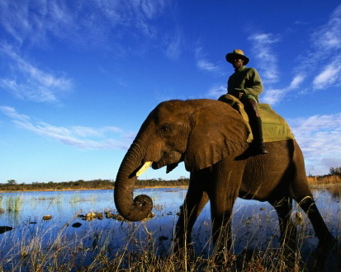
Switch
DIRECT the Rider
MOTIVATE the Elephant
SHAPE the Path
LARC Workbook
Notes:
The Rider – The Rational mind
The Elephant – The Emotional mind
The Path – The Environment
The Rational mind wants to change something at work; The Emotional mind loves the comfort of the existing routine.
To achieve change, both minds will have to be united.

Slide 54
Switch: How to Change Things When Change is Hard
Direct the RIDER | Motivate the ELEPHANT | Shape the PATH
Follow the Bright Spots | Find the Feeling | Tweak the Environment
Script the Critical Moves | Shrink the Change | Build Habits
Point to the Destination | Grow Your People | Rally the Herd
LARC Workbook

Slide 55
Switch: How to Change Things When Change is Hard
Direct the RIDER | Motivate the ELEPHANT | Shape the PATH
Follow the Bright Spots Find what is working well and reproduce | Find the Feeling Appeal to the emotions | Tweak the Environment Modify the environment to make the change “easy”
Script the Critical Moves Give prescriptive direction needed to accomplish the change | Shrink the Change Make change stepwise, with achievable steps | Build Habits Help the change to become “automatic”
Point to the Destination Give the “big picture”, describe the future state | Grow Your People Invest in your people – education, encouragement | Rally the Herd Engage the whole team & all stakeholders
LARC Workbook
Notes:
While all of these elements are important, time constraints will force us to select a few that we will focus on in this course. At the beginning of the project, the focus will be on Motivating the Elephant: Finding the feeling. Other of the elements will be addressed, especially as we talk about methodologies in the Improve phase.

Slide 56

Motivate the Elephant: Find the Feeling
The Glove Shrine
http://heathbrothers.com/member-content/switch-for-organizations-the-workbook/
LARC Workbook
Notes:
Say, “Finding the Feeling is where your change efforts will begin”. Share the story of the “glove shrine” from Switch. Move to the activity slide.
In their book Switch, authors Dan and Chip Heath talk about how to build support for and change existing situations. They cited one situation involving a traveling glove display that has practical applications for instigating any needed changes.
Here’s how it works.
A Purchasing manager wanted to show the consequences of not having a standardized purchasing policy for stock items like gloves, and how it could save their company $1 billion over five years. So he sent an intern around to gather samples of each of the 424 different types of work gloves the company was purchasing.
The Purchasing Manager then labeled the samples with the price paid for each glove, stacked them on a conference room table, and invited the executives in to literally see what their lack of a centralized purchasing policy was costing.
The effect was stunning and visceral. In some cases, the same gloves were being sold by different vendors at different prices. In others, glove quality was lower than needed while in others they were overbuying and paying too much. The executives who saw it had a visceral reaction, which was: this is crazy and has to change. And the traveling glove display helped provide the mandate for the change the Purchasing manager was looking for. (note: for the full story, read Switch).

Slide 57
Activity
What you will need:
Change Management Plan
Problem Statement
Flip Chart Page
Marker
Motivate the Elephant: Find the Feeling
  Can you make the need for change visual?
  The camera crew thought experiment.
  The pivotal testimonial.
  Build your own shrine.
20 minutes
http://heathbrothers.com/member-content/switch-for-organizations-the-workbook/
LARC Workbook
Notes:
Give groups time to engage in the Camera Crew Experiment, determine the “who” for the pivotal testimonial and “what” they might do to “build their own shrine”. Complete the Change Management Plan.

Slide 58
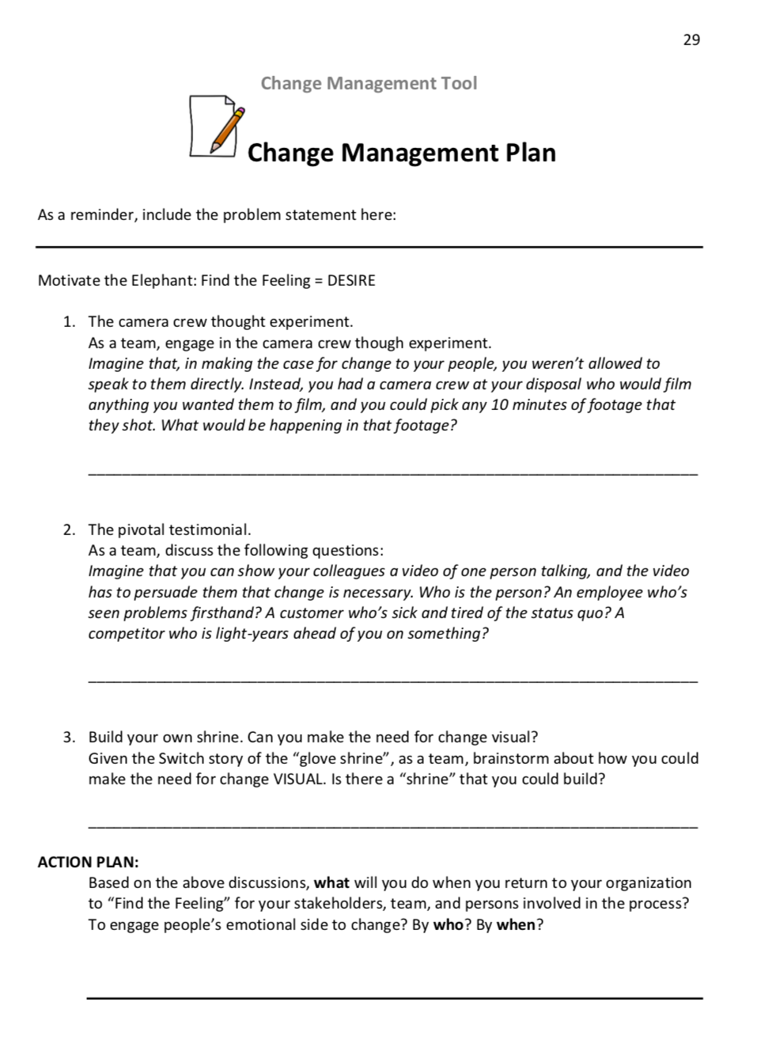
LARC Workbook, p. 29
https://www.larccqi.org/uploads/resources/LARC-3.0-WORKBOOK.pdf
LARC Workbook

Slide 59
Activity
What you will need:
Change Management Plan
Problem Statement
Flip Chart Page
Marker
Motivate the Elephant: Find the Feeling
  Can you make the need for change visual?
  The camera crew thought experiment.
  The pivotal testimonial.
  Build your own shrine.
  Share your action plans.
20 minutes
http://heathbrothers.com/member-content/switch-for-organizations-the-workbook/
LARC Workbook
Notes:
Give groups time to engage in the Camera Crew Experiment, determine the “who” for the pivotal testimonial and “what” they might do to “build their own shrine”. Complete the Change Management Plan.

Slide 60
Switch: How to Change Things When Change is Hard
Direct the RIDER | Motivate the ELEPHANT | Shape the PATH
Follow the Bright Spots Find what is working well and reproduce | Find the Feeling Appeal to the emotions | Tweak the Environment Modify the environment to make the change “easy”
Script the Critical Moves Give prescriptive direction needed to accomplish the change | Shrink the Change Make change stepwise, with achievable steps | Build Habits Help the change to become “automatic”
Point to the Destination Give the “big picture”, describe the future state | Grow Your People Invest in your people – education, encouragement | Rally the Herd Engage the whole team & all stakeholders
LARC Workbook
Notes:
While all of these elements are important, time constraints will force us to select a few that we will focus on in this course. At the beginning of the project, the focus will be on Motivating the Elephant: Finding the feeling. Other of the elements will be addressed, especially as we talk about methodologies in the Improve phase.

Slide 61
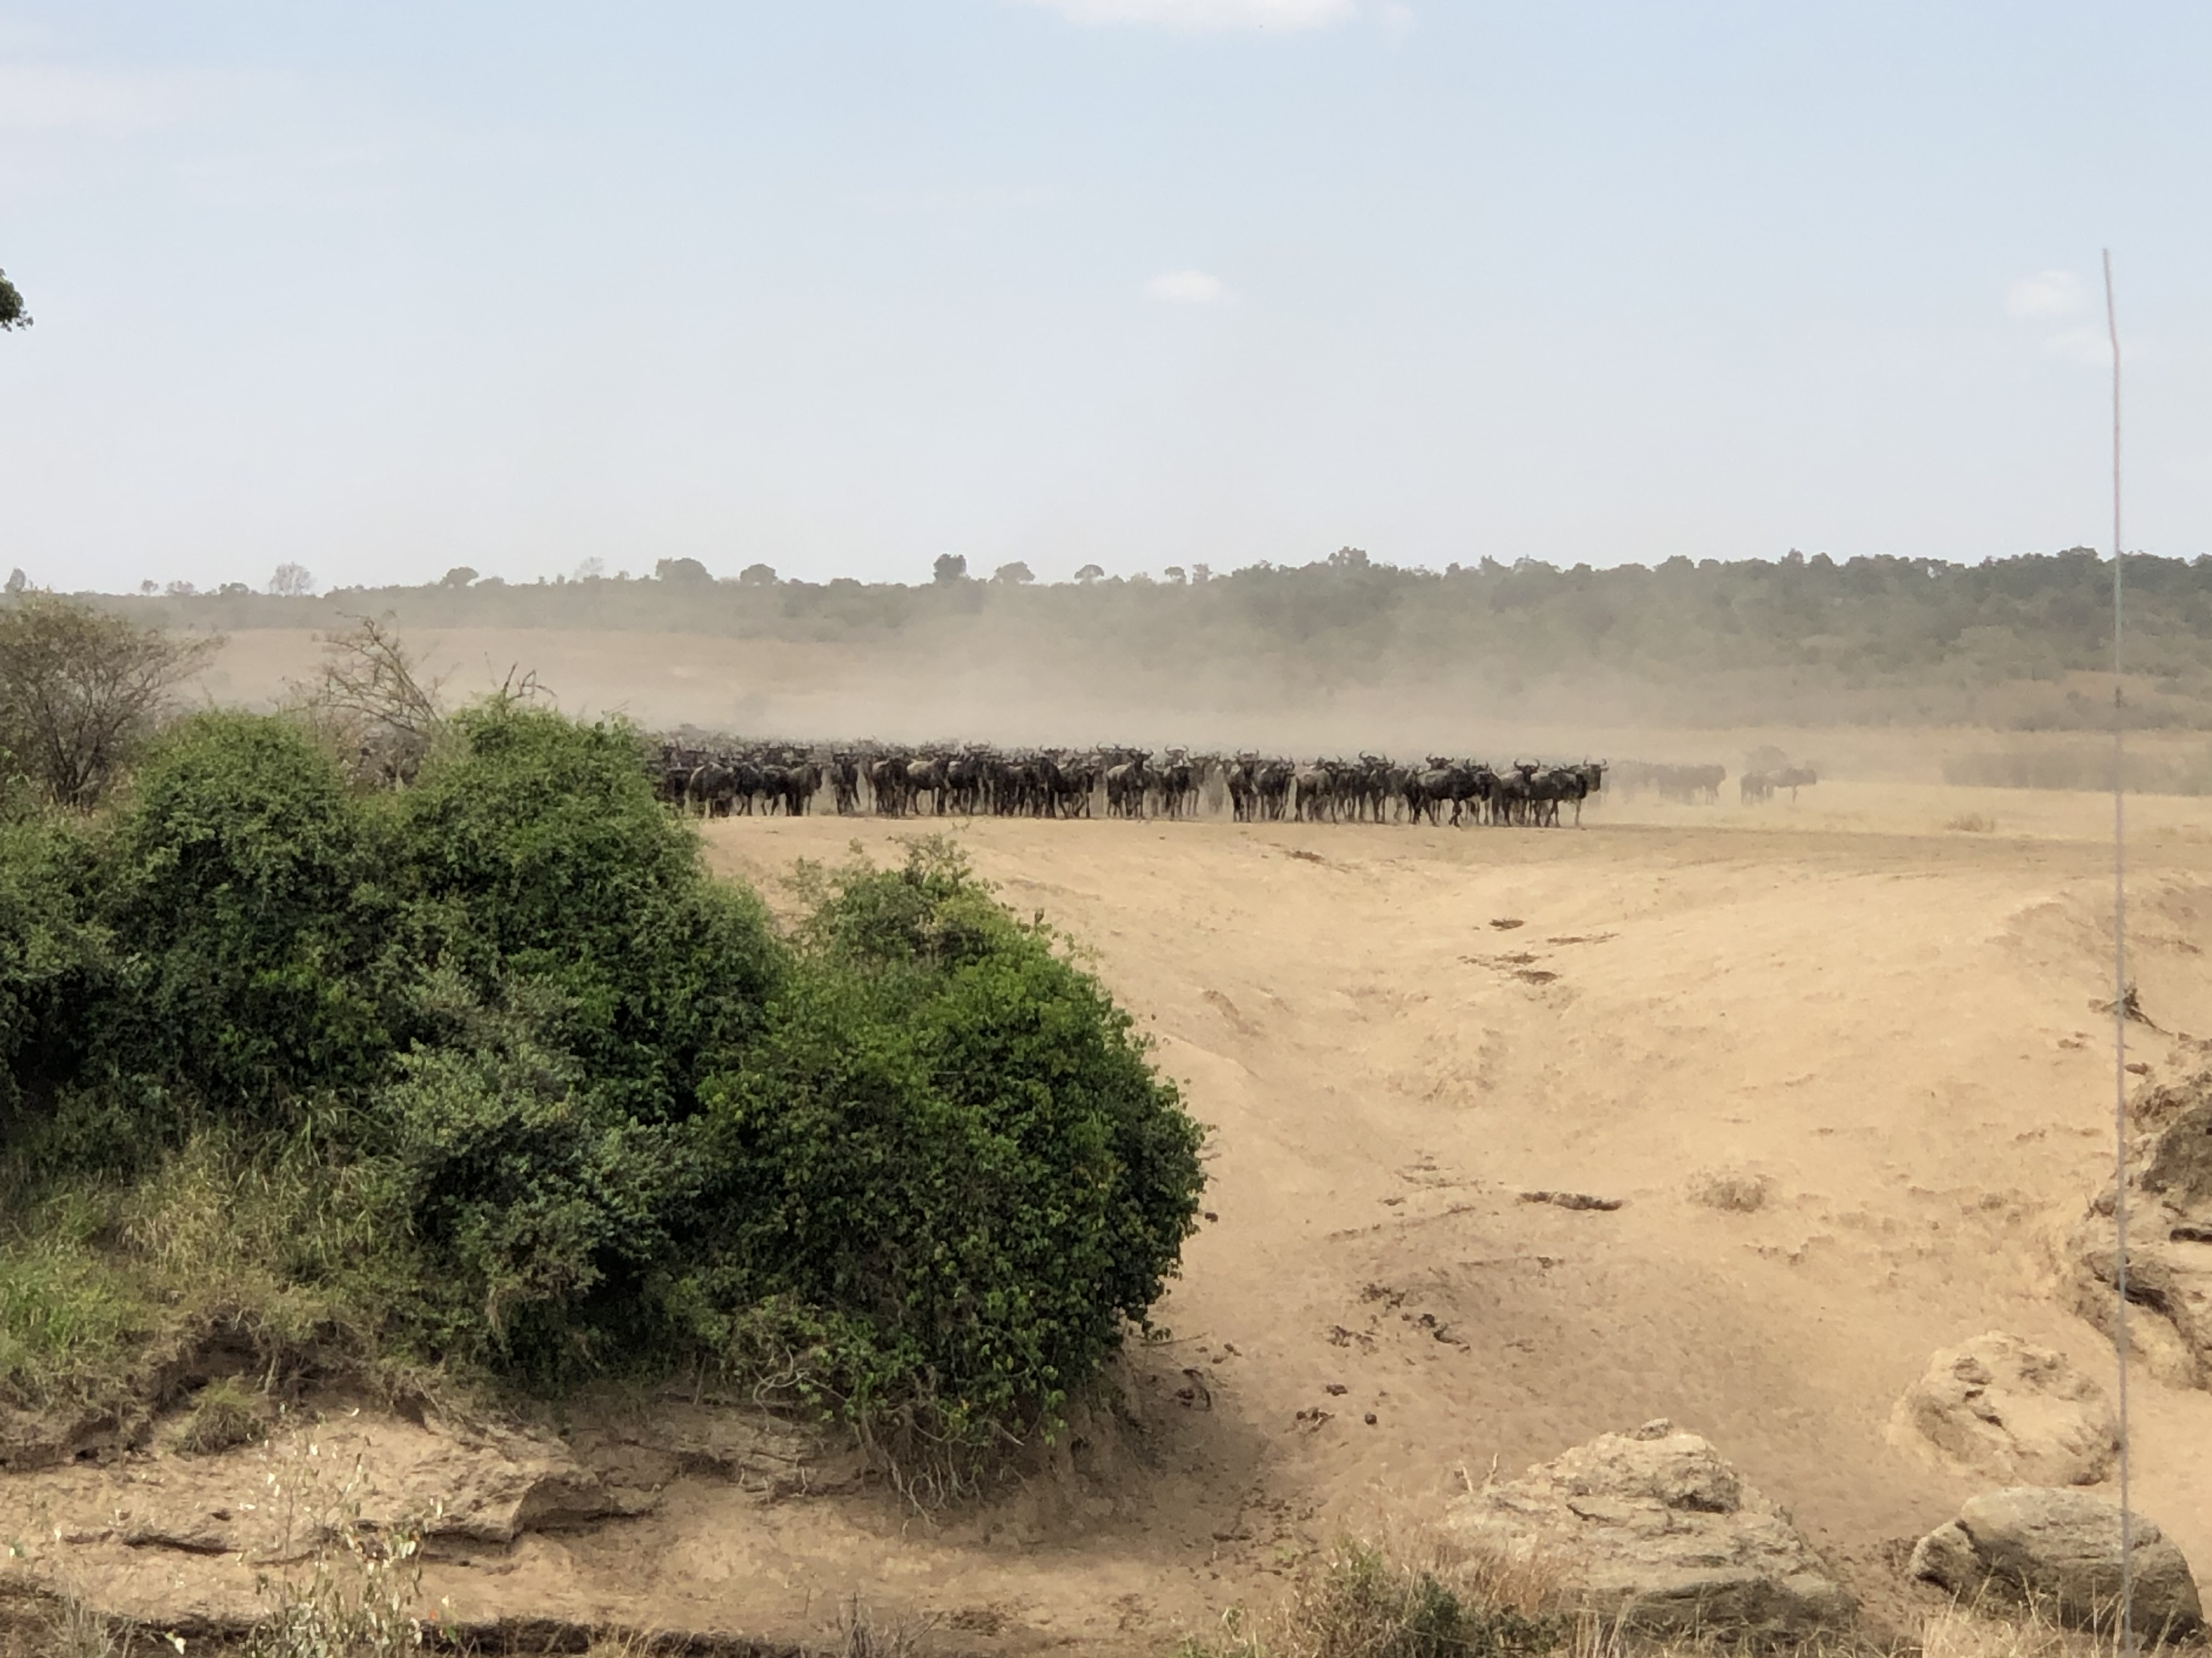
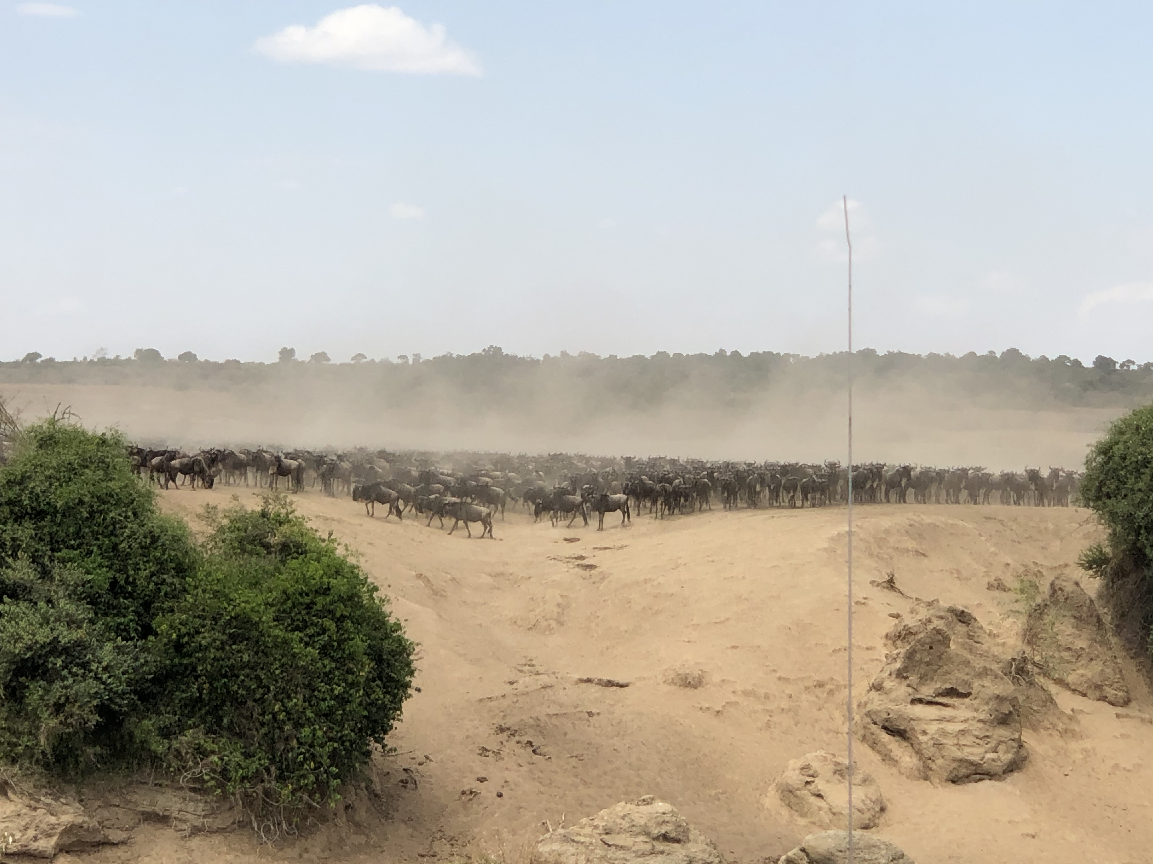
Shape the Path: Rally the Herd
LARC Workbook

Slide 62


PLAY VIDEO
LARC Workbook

Slide 63
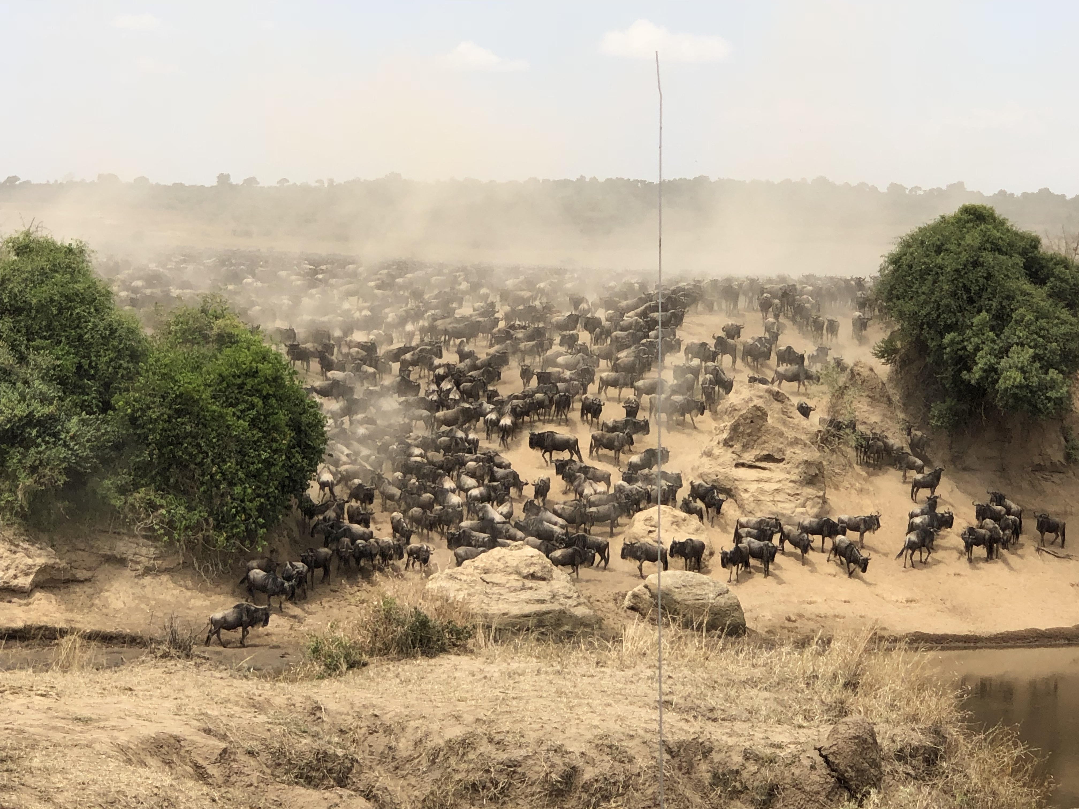
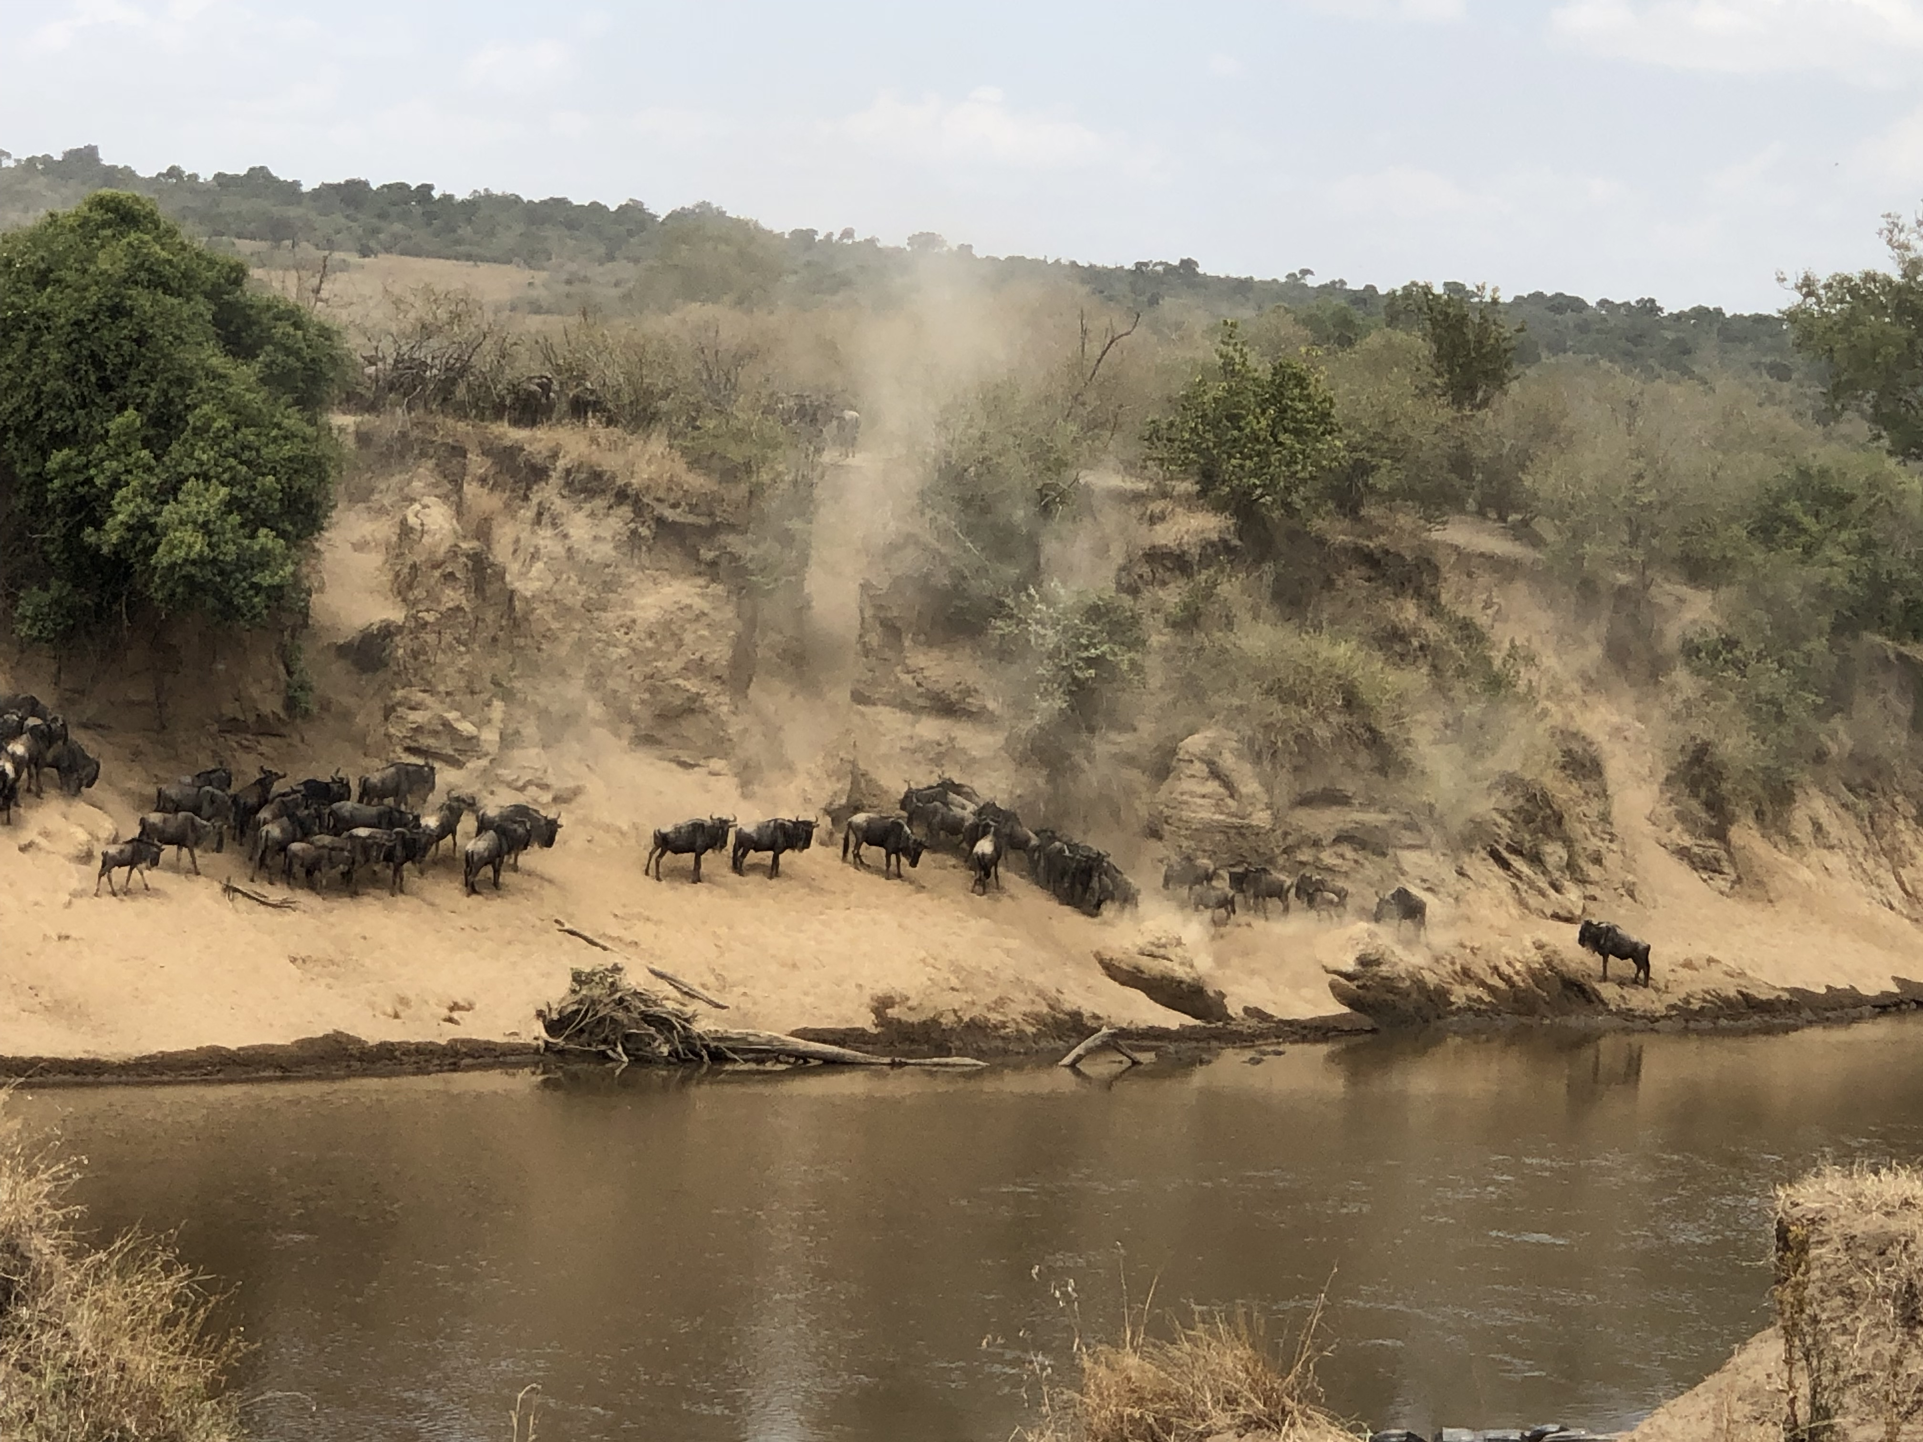
Shape the Path: Rally the Herd
LARC Workbook

Slide 64
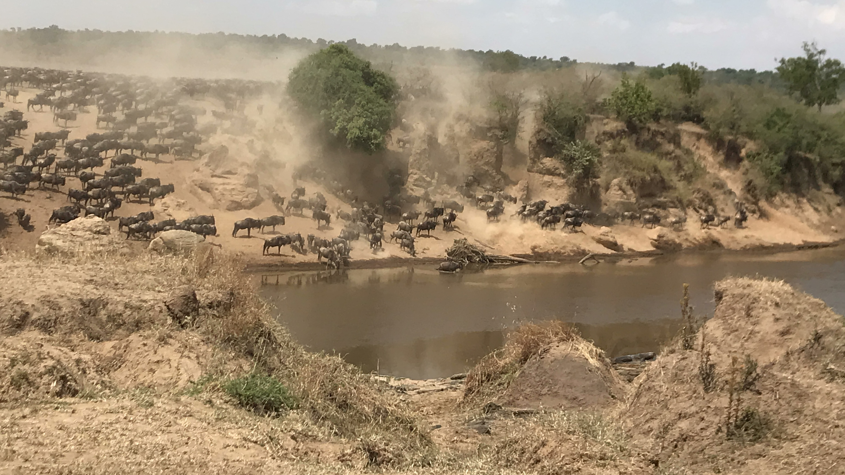
Shape the Path: Rally the Herd
LARC Workbook

Slide 65
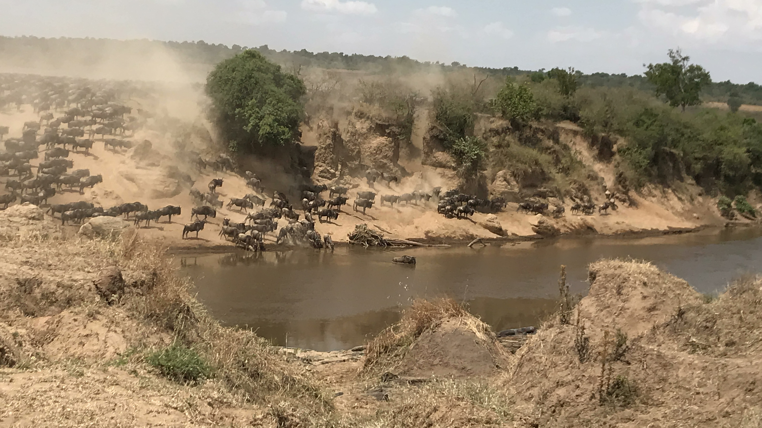
Shape the Path: Rally the Herd
LARC Workbook

Slide 66
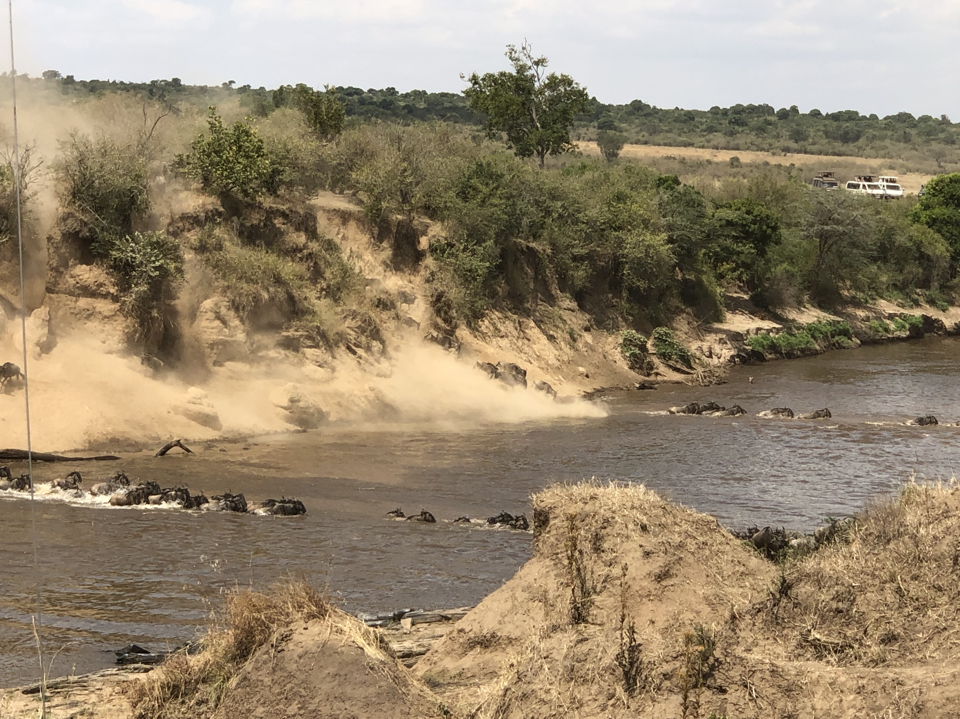
Shape the Path: Rally the Herd
LARC Workbook

Slide 67
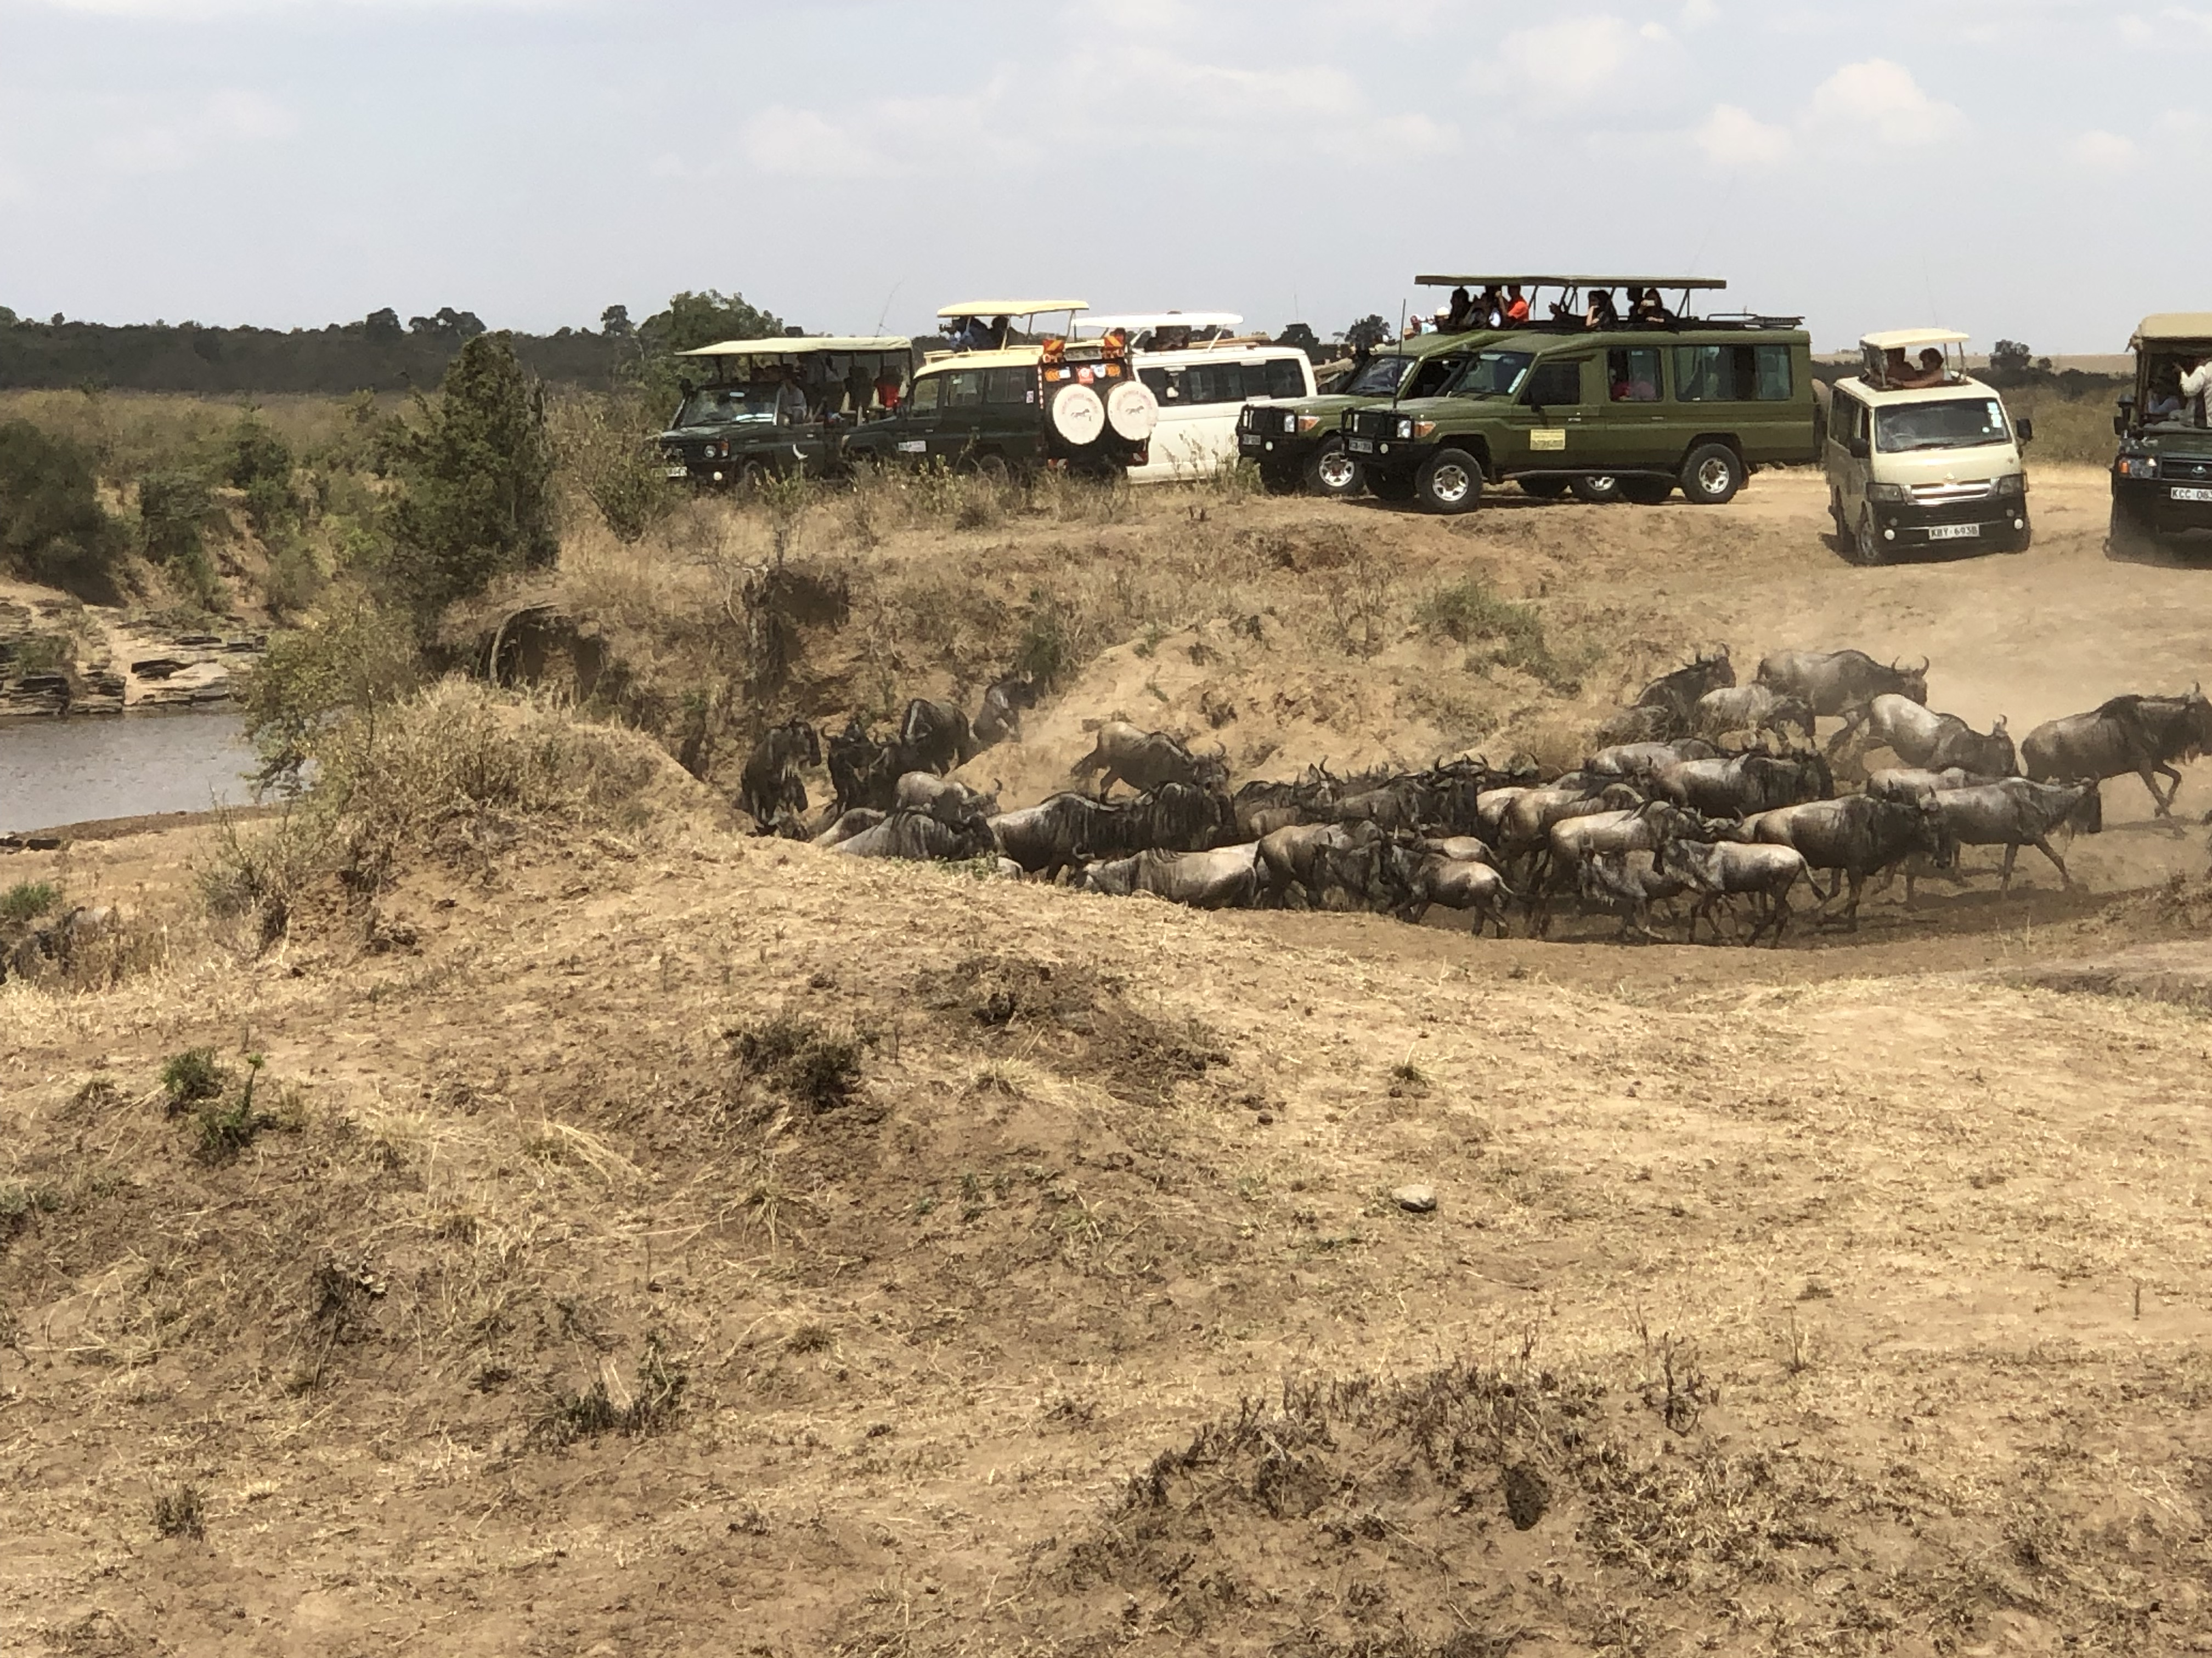
Shape the Path: Rally the Herd
LARC Workbook

Slide 68
Switch: How to Change Things When Change is Hard
Direct the RIDER | Motivate the ELEPHANT | Shape the PATH
Follow the Bright Spots | Find the Feeling | Tweak the Environment
Script the Critical Moves | Shrink the Change | Build Habits
Point to the Destination | Grow Your People | Rally the Herd
LARC Workbook

Slide 69
Direct the Rider: Script the Critical Moves
Be clear about how people should act.
Pick one place to start.
For a change effort to work, leaders have to transform aspirations into actions.
LARC Workbook
Notes:
This idea will be revisited when we address the IMPROVE phase, specifically standardized work & PDSA.

Slide 70



Shape the Path: Tweak the Environment
LARC Workbook
Notes:
Introduce the concept - Change must be made as easy as possible. Share the story of the Staples ”Easy” button and Amazon “1-Click” – marketing master pieces that make buying easy, eliminating extra steps.

Slide 71
Shape the Path: Tweak the Environment
Do a “motion study”.
Emphasize “tweak.”
Do a 5-min rescue on your environment.
Can you 1-Click your process?
Coming Attractions
LARC Workbook
Notes:
We will spend more time on these concepts in the IMPROVE section, when we talk about improvement methodologies such as Lean, 5S, spaghetti diagrams and future state maps.

Slide 72
Switch
DIRECT the Rider
MOTIVATE the Elephant
SHAPE the Path
LARC Workbook
Notes:
The Rider – The Rational mind
The Elephant – The Emotional mind
The Path – The Environment
The Rational mind wants to change something at work; The Emotional mind loves the comfort of the existing routine.
To achieve change, both minds will have to be united.

Slide 73
Deliverables
Change Management Plan
Related Tools:
  Communication Plan
LARC Workbook, p. 27-29
https://www.larccqi.org/uploads/resources/LARC-3.0-WORKBOOK.pdf
LARC Workbook

Slide 74
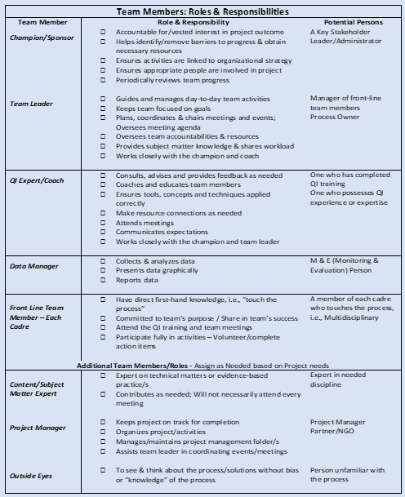
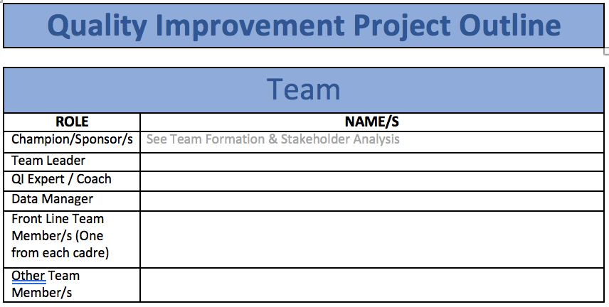
Team Formation
LARC Workbook, p. 30-32
https://www.larccqi.org/uploads/resources/LARC-3.0-WORKBOOK.pdf
LARC Workbook

Slide 75
Team Functional Assessment: Planning for Spread
Novice Team
Meets weekly; manager and director are engaged and present
Has begun small tests of change with PDSA documentation
Working on building a team and seeing failure in a positive light
Strong Team
Has implemented more than three successful initiatives in the unit
Is submitting measures
Advanced Team
Has met or exceeded project performance targets
Mentors other teams
LARC Workbook

Slide 76
Questions?

